Slide 1
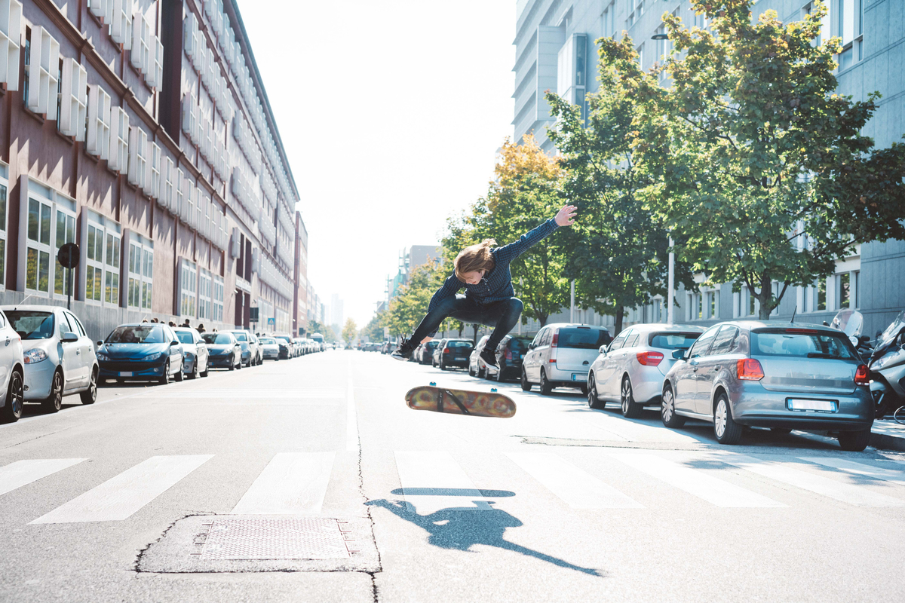
Skateboard99.2 %Sport99.2 %Sports99.2 %Human99.2 %People99.2 %Person99.2 %Parking97.4 %Parking Lot97.4 %Automobile91.5 %Car91.5 %Transportation91.5 %Vehicle91.5 %Intersection76.8 %Road76.8 %Path76.2 %Pavement76.2 %Sidewalk76.2 %Walkway76.2 %Building66.7 %Coupe62 %Sports Car62 %Urban61.9 %Neighborhood60.9 %Sedan59.2 %City57.3 %Town57.3 %Street56.4 %Housing54.2 %Downtown53.8 %Office Building52 %Suv51.3 %Apartment Building51.2 %High Rise51.2 %Pedestrian50.6 %Freeway50.5 %Bumper50.5 %

Slide 2
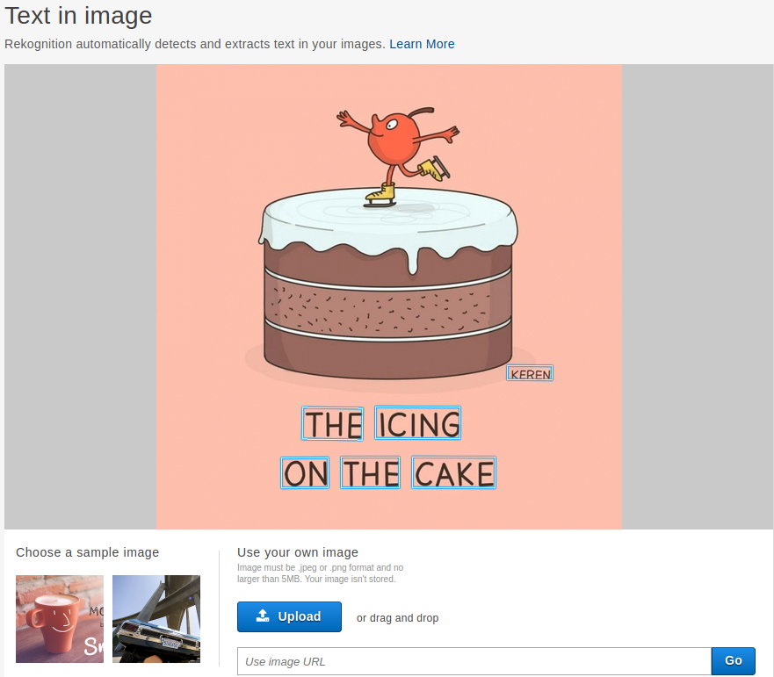
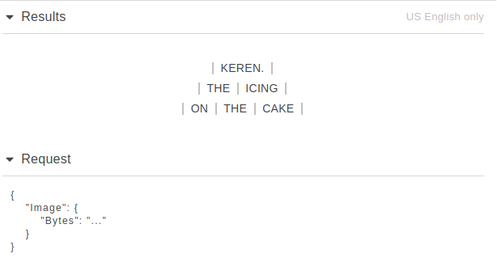
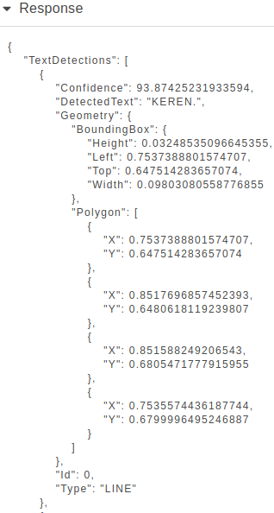
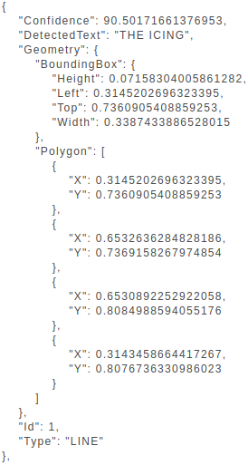

Slide 3
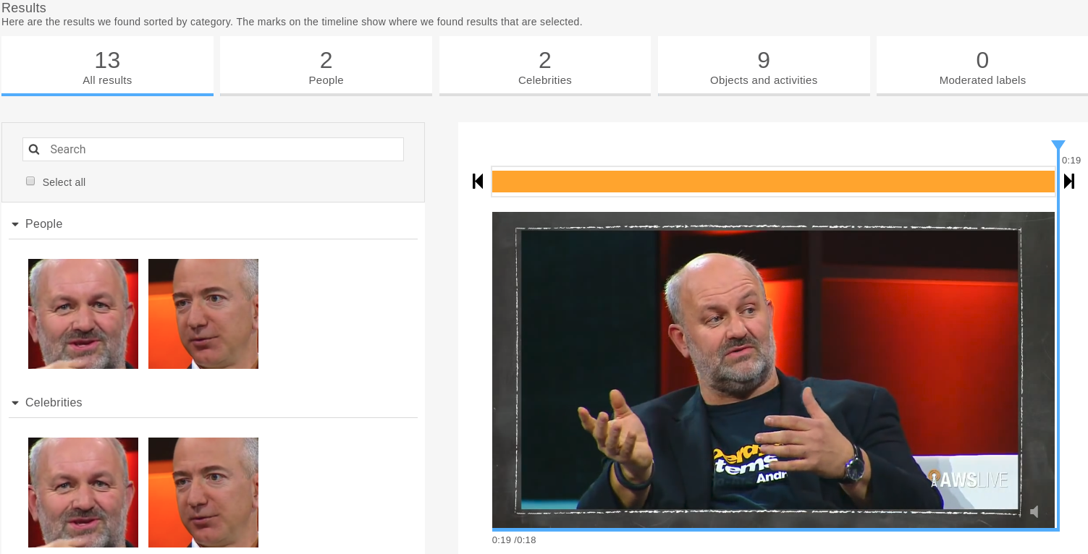
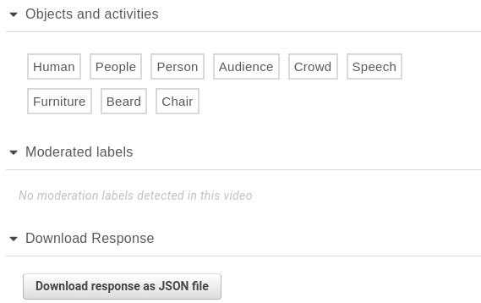

Slide 4
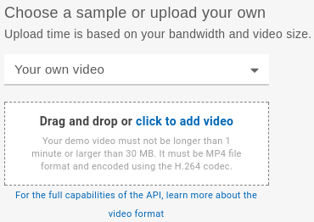

Slide 5
